Slide 1

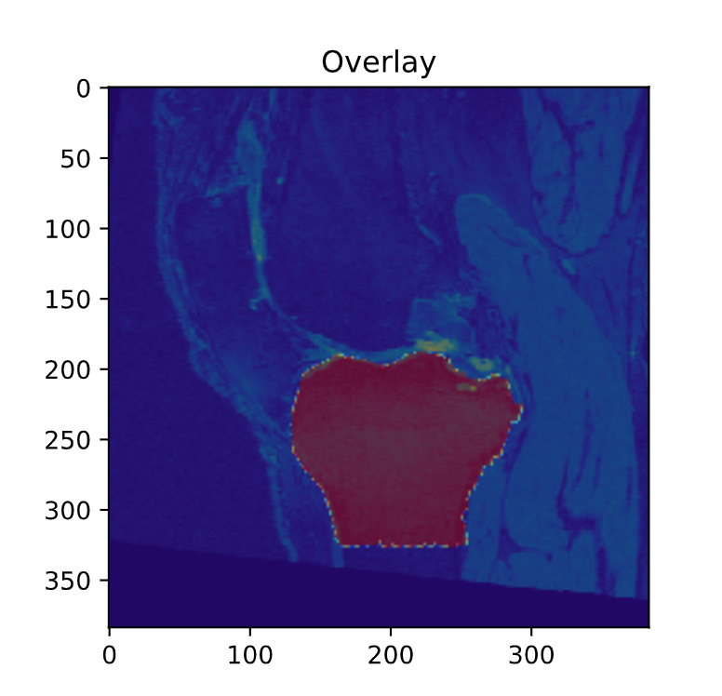
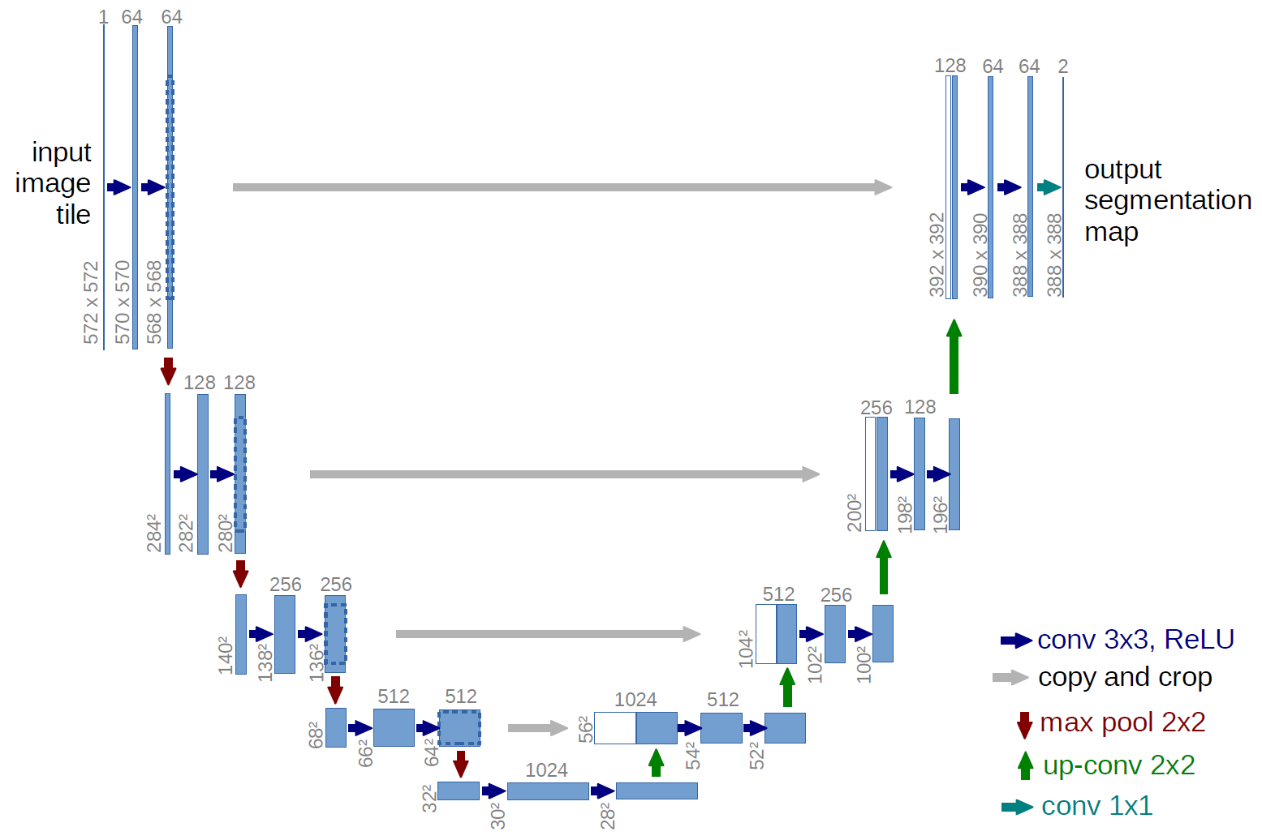
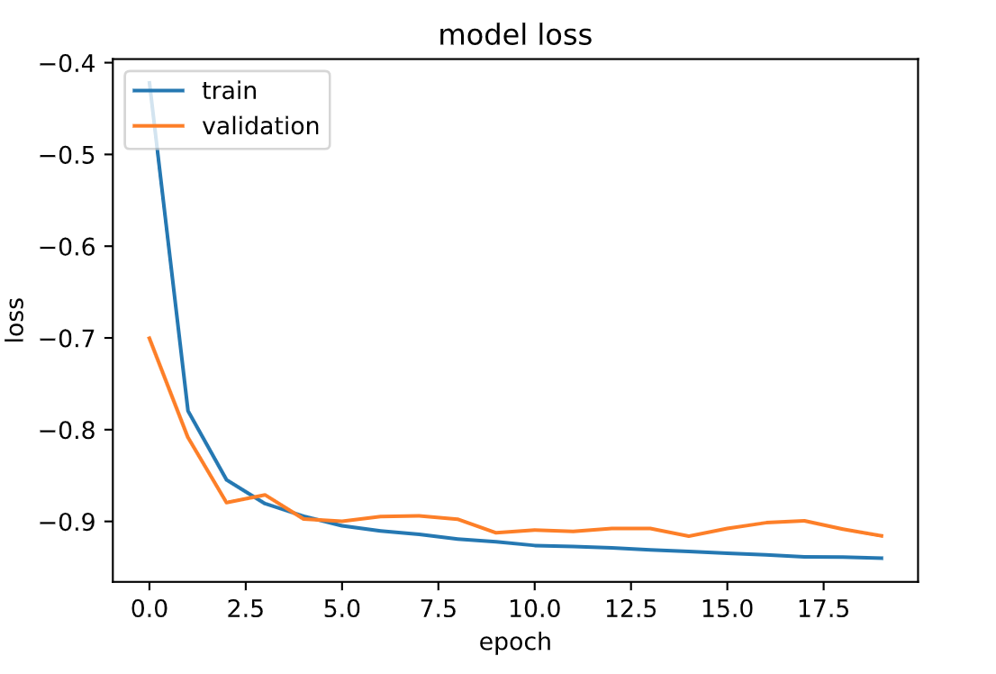
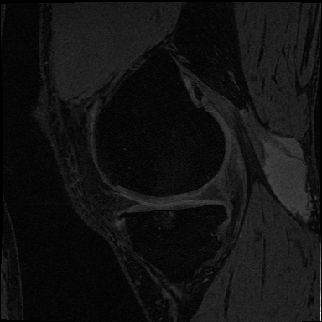
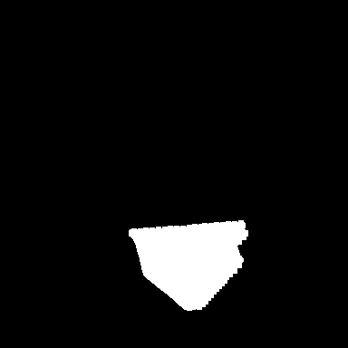
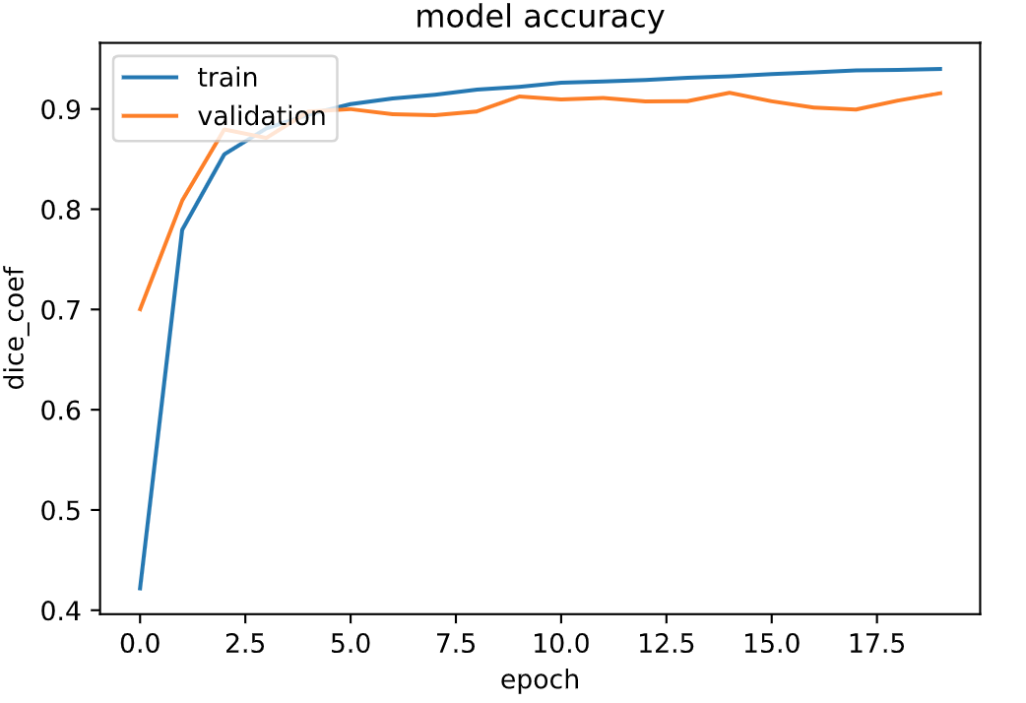
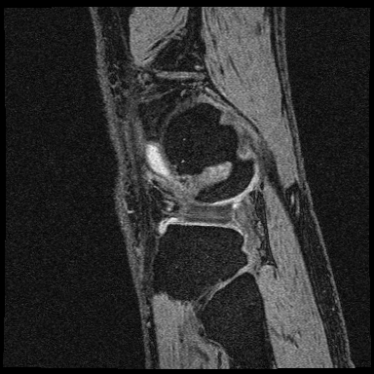

Deep learning for Knee Bone Segmentation
Ian Carvalho, Dishant Desai
INTRODUCTION
RESULTS
This work uses image segmentation techniques in order to correctly segment the Knee Tibia bone. In image segmentation, the main goal is to partition a digital image into a set of pixels and it’s usually used for locating objects and boundaries in images [1].
In the medical field, It’s relevant to apply Deep Learning to segmentation problems, it’s usually a time consuming process that requires expertise. Deep learning systems usually are adopted under the supervision of a certified doctor because of liability issues. But considering that, given enough data, some Artificial Intelligence models are already more accurate, on average, than doctors, these tools provide a valuable resource inside the hospitals.
The results from each experiments were gather and are described in the table below. As expected, the augmented experiment got a slight better performance, but at the cost of a longer training time.
Experiment | Partial | Full | Augmented
Epochs | 41 | 15 | 15
Training Score | 0.926 | 0.932 | 0.932
Validation Score | 0.884 | 0.915 | 0.916
Testing Score | 0.898 | 0.903 | 0.905
U-Net Architecture [2]
Dataset
METHODOLOGY
Segmentation Example
CONCLUSION
The dataset consisted in MRI images from knee of different patients. As the main goal of this work was to successfully segment the Tibia bone, the dataset was label by drawing a mask around the bone area for each slice of the MRI.
After the labeling, images would be converted to PNG format and split into training, validation and testing dataset with the following ratios: 0.6/0.2/0.2.
Preprocessing techniques were used to standardize the image and center the pixel values according to a normal distribution.
Once the dataset was labeled and preprocessed, training, validation and testing dataset were split taking care to not separate images from the same subjects, as this could lead to bleeding information from testing set into the training set, which could impact performance on a totally new dataset.
Image augmentation techniques were use to increase the size of the training dataset. Rotation, shift, and zoom transformations were applied to the training dataset increasing it to a factor of 2.
The Unet Architecture, as described in [2], was the chosen architecture because of its proven efficiency [1] for medical image segmentation. Because of the reduced size of the dataset, using a more complex model would probably lead to overfitting, even considering the image augmentations. Dice score was chosen as the evaluation metric.
The model was trained in batches of 8 images until the Dice score on the validation set would not increase for 5 epochs.
Three experiments were realized and their scores, compared. Each of the experiments used a different number of images for training.
The first experiment, used the images from 10 subjects split as described. The second experiment used all images in the dataset and the final experiment applied image augmentation to the full dataset as described before.
Even though, I reasonable Dice score was achieved with the partial dataset, it’s noticeable the gap between training and testing scores, indicating overfitting. All three experiments were able to successfully segment the bone in most of the cases. The augmented obtained a slight better performance, but it didn’t justify the longer running time. Further investigation is necessary for testing the impact of different hyper-parameters as learning rate and batch size to the performance.
References
[1] Pham, Dzung L., Chenyang Xu, and Jerry L. Prince. "Current methods in medical image segmentation." Annual review of biomedical engineering 2.1 (2000): 315-337.
[2] Long, Jonathan, Evan Shelhamer, and Trevor Darrell. "Fully convolutional networks for semantic segmentation." Proceedings of the IEEE conference on computer vision and pattern recognition. 2015.Long, J., Shelhamer, E., & Darrell, T. (2011)
Training History for Augmented Dataset
Sample of dataset: Images and Labeling

